Slide 1

A Christ-Centered SEL & Leadership Formation Program
Bishop Diego High School • Grades 9-12

Slide 2
FRESHMAN • GRADE 9
Living Life in Color
Introduces the foundational concept that emotions are non-judgmental signals that lead to adaptive actions. Students learn to identify core emotions (anger, sadness, fear, joy), their corresponding signals, and their functions using the Zones of Regulation framework.
CASEL FOCUS
Self-Awareness & Self-Management
CST LENS
Dignity of the Human Person

Slide 3
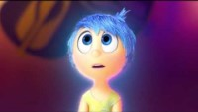

Slide 4
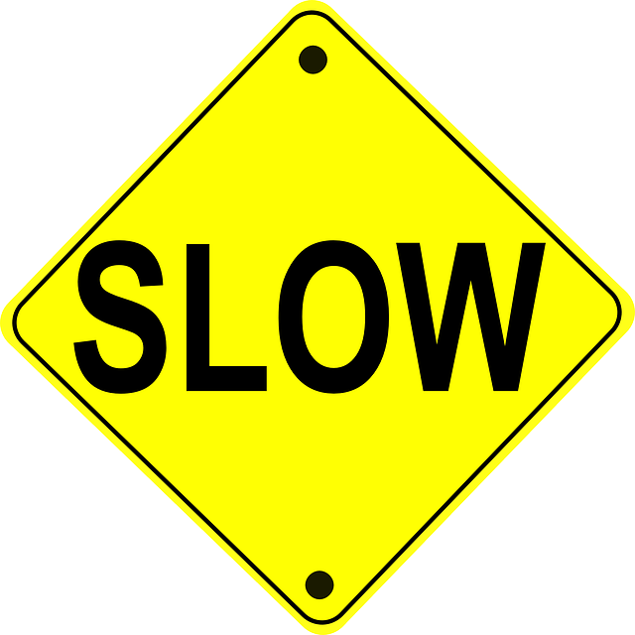

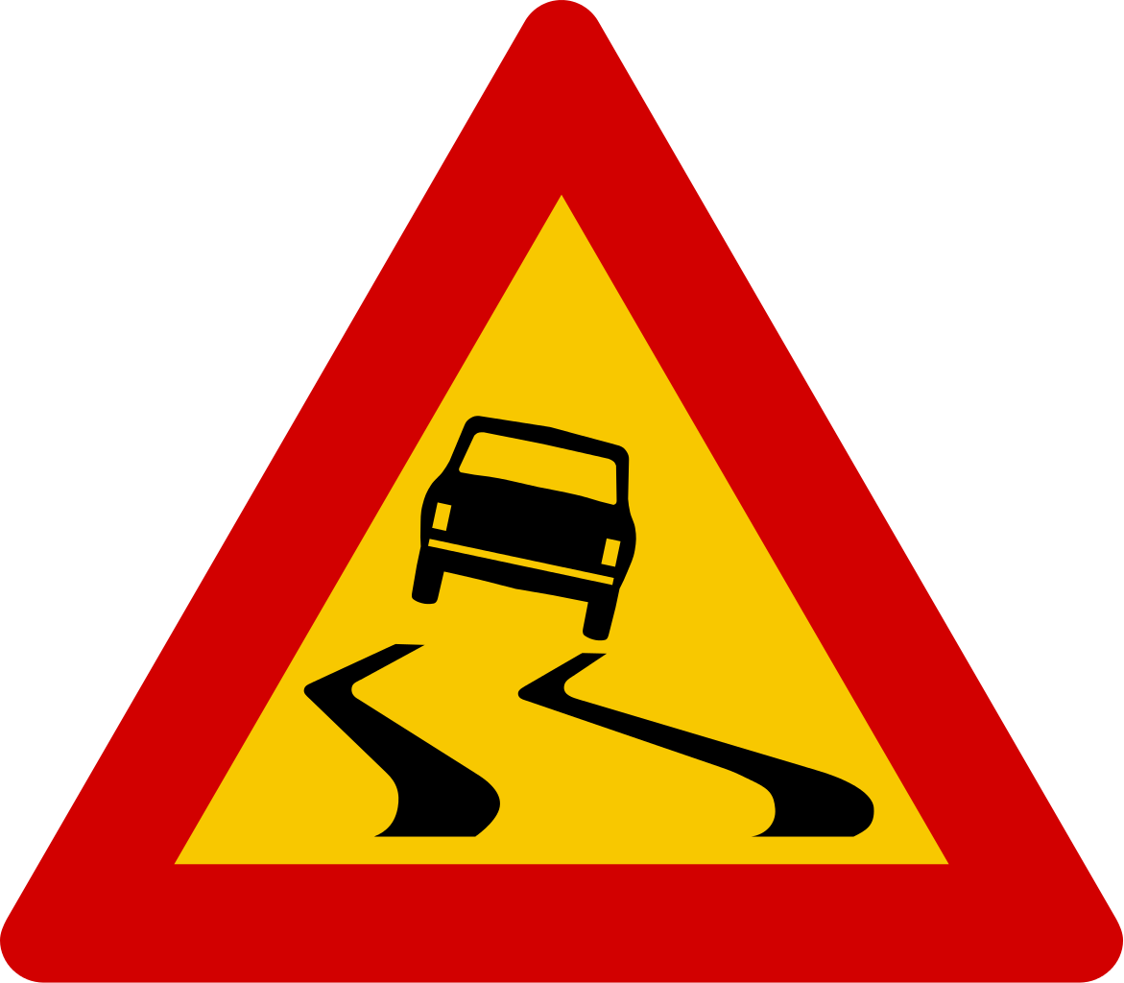
Emotions are Signals
Emotions are neither “good” nor “bad.” They are signals. (…When you feel and deal with them).
Signals lead to an adaptive action (an action you take because you see the signal)

Slide 5


Group Activity: Fill out the following chart
Emotions | Anger | Sadness | Fear | Disgust | Joy | Excitement | Pride
Signals
Associated action

Slide 6
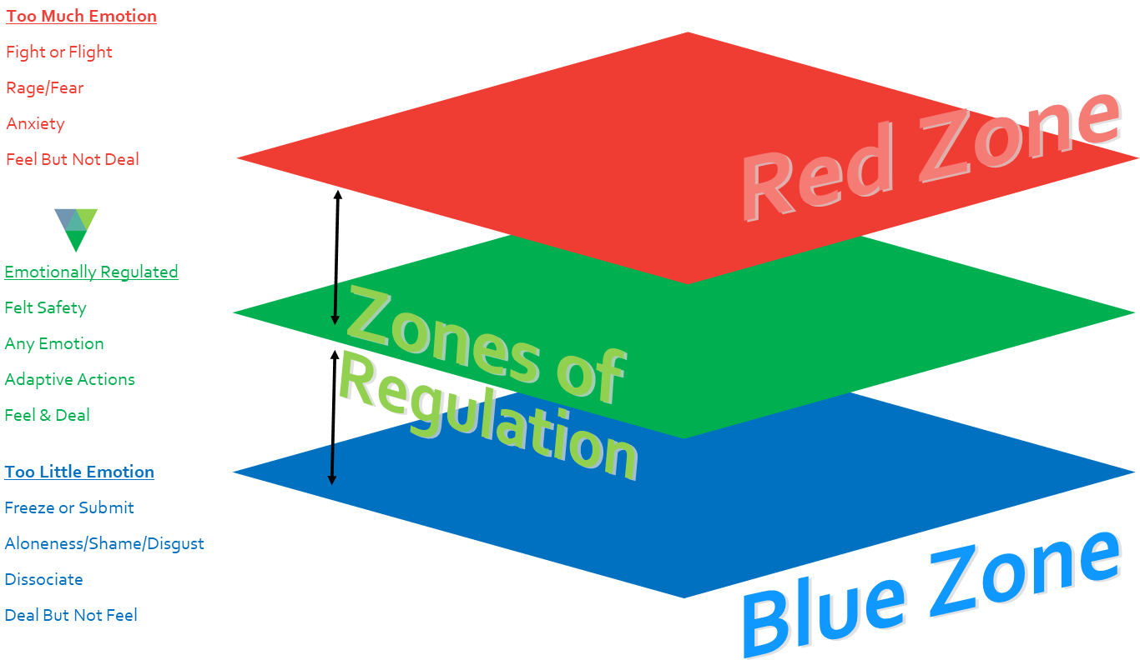

Slide 7
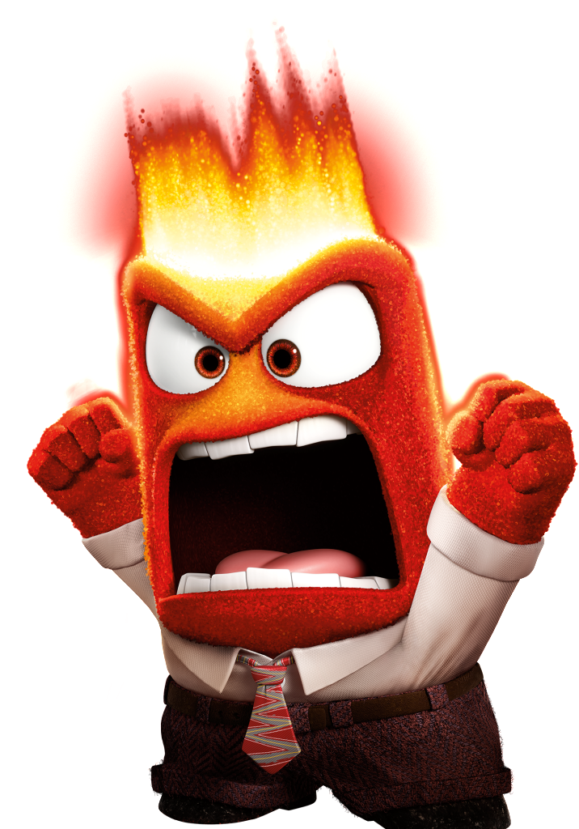
Anger
What does anger signal? (What does it mean when you feel anger?)
What is anger’s adaptive action? (What does anger lead you to do?)
Notes:
This Photo by Unknown Author is licensed under CC BY

Slide 8
Anger
Anger signals, “I don’t like it.”
What is anger’s adaptive action? (What does anger lead you to do?)
Notes:
This Photo by Unknown Author is licensed under CC BY

Slide 9
Anger
Anger signals, “I don’t like it.”
The adaptive action associated with anger is “push back or say no.”
What happens if you don’t feel and deal with anger?
Notes:
This Photo by Unknown Author is licensed under CC BY

Slide 10
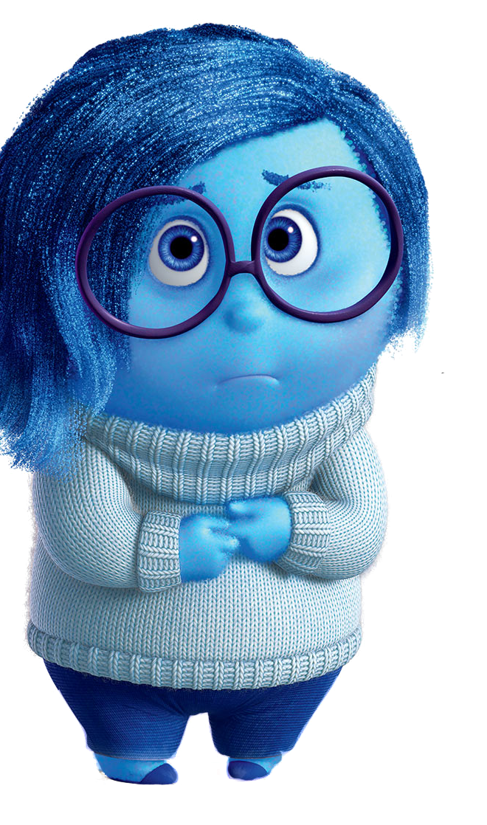
Sadness
What does sadness signal? (What does it mean when you feel sad?)
What is the adaptive action of sadness? (What does feeling sad lead you to do?)
Notes:
This Photo by Unknown Author is licensed under CC BY-SA

Slide 11
Sadness
Sadness signals, “I value this.”
What is the adaptive action of sadness? (What does feeling sad lead you to do?)
Notes:
This Photo by Unknown Author is licensed under CC BY-SA

Slide 12
Sadness
Sadness signals, “I value this”
The adaptive action tendency associated with sadness is to “grieve your losses”
What happens when you don’t feel and deal with sadness?
Notes:
This Photo by Unknown Author is licensed under CC BY-SA

Slide 13
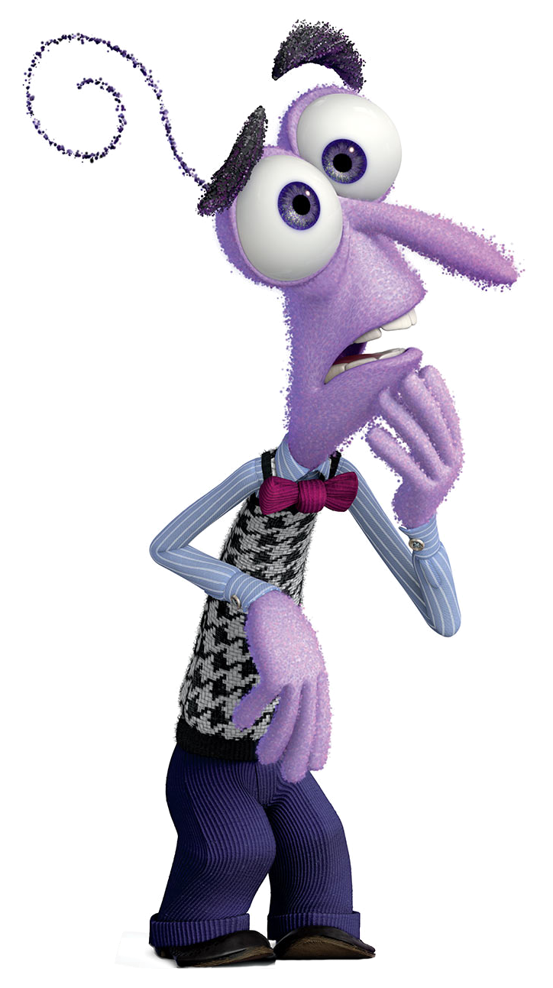
Fear
What does fear signal? (What does it mean when you feel fear?)
What is fear’s adaptive action? (What does fear lead you to do?)
Notes:
This Photo by Unknown Author is licensed under CC BY-SA-NC

Slide 14
Fear
Fear signals, “I am unsafe”
What is fear’s adaptive action? (What does fear lead you to do?)
Notes:
This Photo by Unknown Author is licensed under CC BY-SA-NC

Slide 15
Fear
Fear signals, “I am unsafe”
Fear’s associated adaptive action tendency is to flee to safety.
What happens when you don’t feel and deal with fear?
Notes:
This Photo by Unknown Author is licensed under CC BY-SA-NC

Slide 16
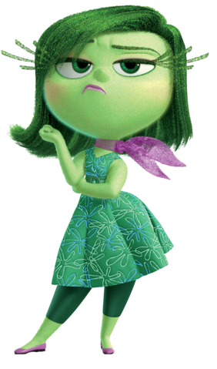
Disgust
What does disgust signal? (What does it mean when you feel disgust?)
What is disgust’s adaptive action? (What does disgust lead you to do?)

Slide 17
Disgust
Disgust signals, “I am being contaminated.”
What is disgust’s adaptive action? (What does disgust lead you to do?)

Slide 18
Disgust
Disgust signals, “I am being contaminated.”
The adaptive action tendency associated with disgust is to expel the contaminate.
What happens when we don’t feel and deal with disgust?

Slide 19
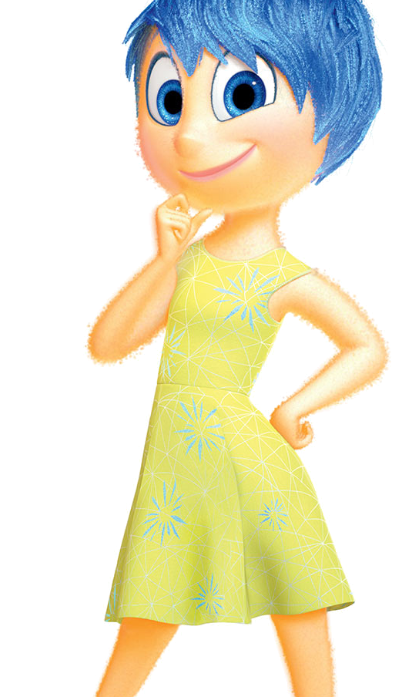
Joy
What does joy signal? (What does it mean when you feel joy?)
What is joy’s adaptive action? (What does joy lead you to do?)
Notes:
This Photo by Unknown Author is licensed under CC BY-SA

Slide 20
Joy
Joy signals, “I like this.”
What is joy’s adaptive action? (What does joy lead you to do?)
Notes:
This Photo by Unknown Author is licensed under CC BY-SA

Slide 21
Joy
Joy signals, “I like this.”
The adaptive action associated with joy is to celebrate.
What happens when you don’t feel and deal with joy?
Notes:
This Photo by Unknown Author is licensed under CC BY-SA

Slide 22
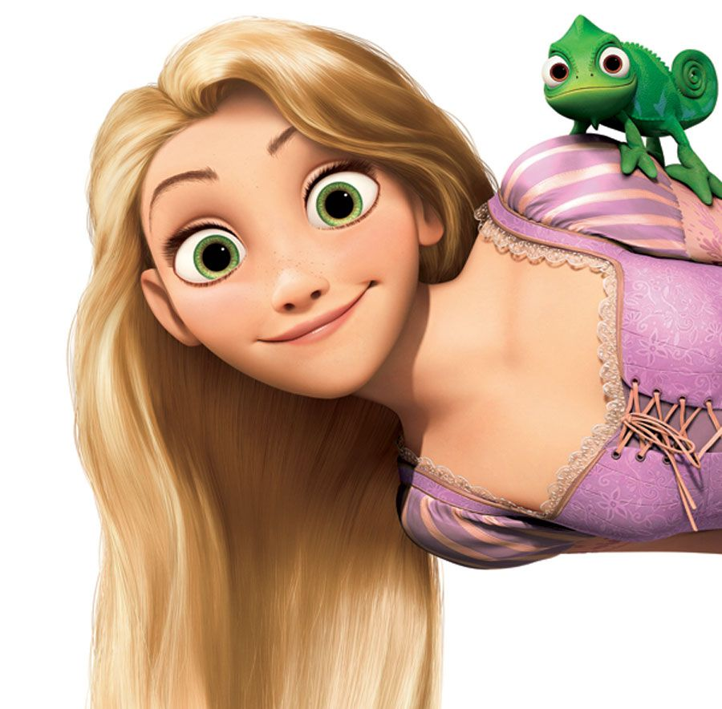
Excitement
What does excitement signal? (What does it mean when you feel excited?)
What is excitement’s adaptive action? (What does excitement lead you to do?)

Slide 23
Excitement
Excitement signal’s “Something good will occur.”
What is excitement’s adaptive action? (What does excitement lead you to do?)

Slide 24
Excitement
Excitement signal’s “Something good will occur.”
Excitement’s associated adaptive action tendency is to go towards it.

Slide 25
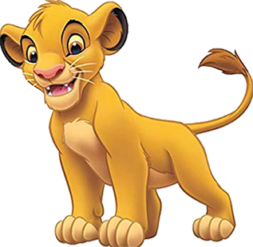
Pride
What does Pride signal? (What does it mean when you feel excited?)
What is pride’s adaptive action? (What does excitement lead you to do?)

Slide 26
Pride
Pride signal’s “I did it.”
What is pride’s adaptive action? (What does excitement lead you to do?)

Slide 27
Pride
Pride signal’s “I did it.”
Pride’s adaptive action tendency is to celebrate.

Slide 28

Emotions Floor Check

Slide 29
What is available for Bishop Students?
As a personal counselor, I am available to meet with you to help you process difficult to process life circumstances.
Feel free to come to my office, or to email me if you desire to meet with me one on one.
Mr. Eggman: AEggman@bishopdiego.org.
•
•
•
•

Slide 30

Music Playlist
Work in a group of no more than four people and select a song that you can play to remind you of a given emotion:
Anger, Sadness, Fear, Disgust, Joy, Excitement, Pride
Notes:
1.)

Slide 31
Questions?

